Slide 1
INTRODUCTION TO COMP SCI/ PROGRAMMING PARIDIGM & MURACH CHP 1-9 REVIEW

Slide 2
TOPICS
DATA TYPES & VARIABLES
SCOPE
BOOLEAN EXPRESSIONS (TRUE/FALSE)
CONDITIONAL STATEMENTS (IF/ELSE)
LOOPS (FOR/WHILE)
METHODS & EVENT HANDLERS (FUNCTIONS)
EXCEPTION HANDLING (TRY/CATCH)
DATA VALIDATION
ARRAYS [ ]
DATES
STRING & DATE FORMATING

Slide 3


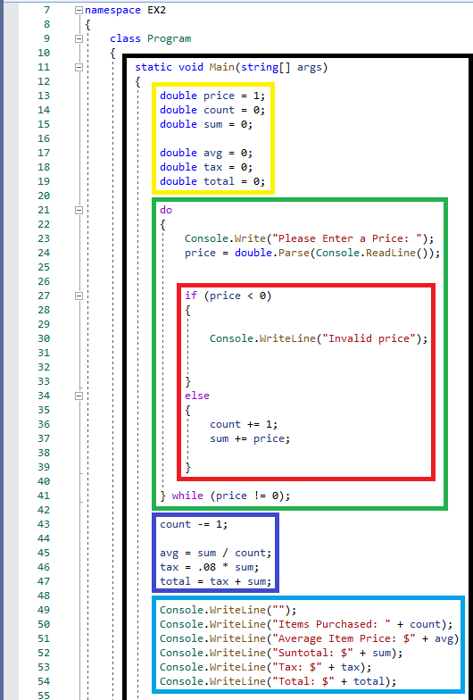
Programming paradigm
Black : Main Function() {
* for the time being, this will be where all our code lies within }
Yellow : data type/ variable declarations =
* This will always be the first part of your program/ scope.
* If you need to declare constants they should be listed first.
* you do not have to set values here, ex: ( double price; ) is a valid declaration.
* You do not need to add any letters after your number declarations, because they are simply no longer useful often.

Slide 4
Programming paradigm cont.
Green : loops {
* in this program I wrote each of our console.writelines() only when the user enters a valid entry that = 0; instead of partly each time & fully only when the user types 0, for which I received -4 points.
* Each case is different but in general, the following is a list of loops and when you should use them:
while loop: while (condition) { loops through a block of code if a specified condition is True. ex:
x = 0;
while ( x < 5; ) { x++; }
do-while loop: do { } while { This loop will execute the code block once, before checking if the condition is true, then it will repeat the loop if the condition is true. Ex:
do { x++; }
while ( x <= 5; ) }
* rule of thumb: use a do-while loop when you know you want a piece of code to run at least one time, but possibly many times.

Slide 5
Programming paradigm cont.
for loop: for ( int x = n; x < m; x++; ) {
* When you know exactly how many times you want to loop through a block of code, use the for loop instead of a while loop. EX:
for ( int x = 0; x < 5; x++; ) {
Console.WriteLine(i);
};
for-each loop: foreach ( string I in cars; ) {
* There is also a foreach loop, which is used exclusively to loop through elements in an array. Ex:
string[ ] cars = {"Volvo", "BMW", "Ford", "Mazda"};
foreach (string I in cars) {
Console.WriteLine(I);
};
* rule of thumb: you should use a for loop when a while loop just isn’t enough. The for loop is technically just a while loop with a counter and a set variable.

Slide 6
Programming paradigm cont.
red : data validation (if/else) {
* Use the if statement to specify a block of C# code to be executed if a condition is True. Ex:
int x = 20;
int y = 18;
if (x > y) {
Console.WriteLine("x is greater than y"); }
* the reason we used our if/else inside of our do-while loop is because we want the program to check the if else statement every time the price entered does not equal zero. If we only needed to check price for one entry, the loop would be unnecessary.
* Loops are for doing things multiple times, and if/else statements check if something is true or false.

